Slide 1

Case Studies
Inception network
deeplearning.ai

Slide 2
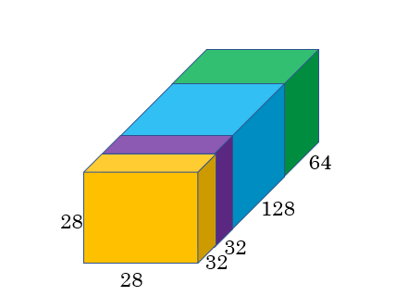
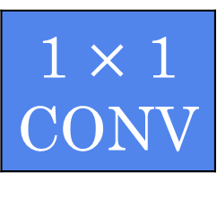
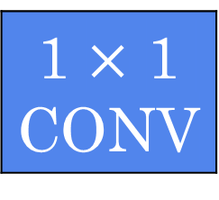
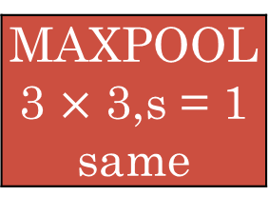
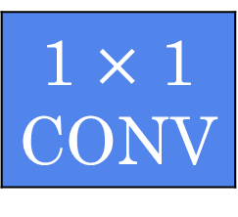
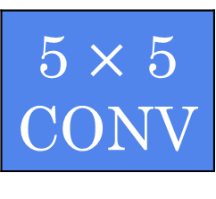
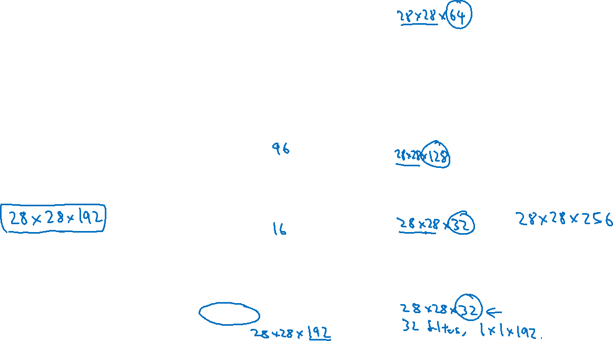

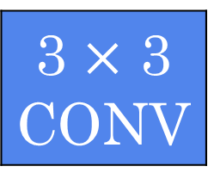
Inception module
1 $×$ 1 CONV
1 $×$ 1 CONV
3 $×$ 3 CONV
Previous Activation
Channel Concat
1 $×$ 1 CONV
5 $×$ 5 CONV
MAXPOOL 3 $×$ 3,s = 1 same
1 $×$ 1 CONV

Slide 3
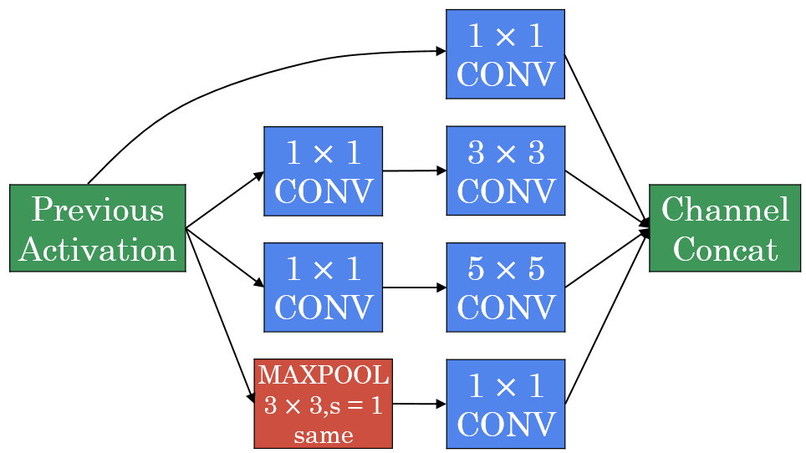

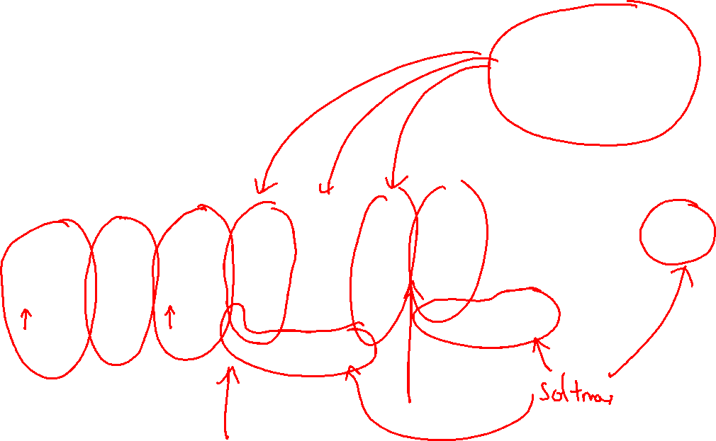

Inception network
[Szegedy et al., 2014, Going Deeper with Convolutions]

Slide 4
http://knowyourmeme.com/memes/we-need-to-go-deeper

